Slide 1



Crop and Fertilizer Recommendation System using Machine Learning
Name: Dipanshu Dhage
Email Id:dipanshu9131@gmail.com

Slide 2

Learning Objectives
Understand the challenges in modern agriculture related to crop and fertilizer selection.
Learn how machine learning can solve real-world agricultural problems.
Gain practical experience in:
Data preprocessing and analysis
Training and evaluating ML models
Building a user interface using Streamlit
Deploying a complete AI application
Apply OCR techniques to extract data from documents.
Learn how to manage projects using GitHub.
GOAL

Slide 3

Tools And Technology Used
Python: Main programming language for the project.
Streamlit: Framework for building the interactive web interface.
pandas: For data manipulation and analysis.
scikit-learn: Used to train machine learning models (Random Forest).
pytesseract: Extracts text from image-based soil reports (OCR).
PyMuPDF (fitz): Extracts text from PDF soil reports.
GitHub: For version control and project management.

Slide 4
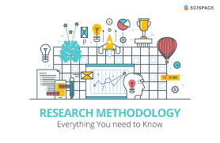
Methodology
Data Collection: Gather and preprocess datasets for crops and fertilizers.
Model Training: Train Random Forest models to predict crops and fertilizers.
OCR Extraction: Use pytesseract to extract soil data from uploaded images or PDFs.
Streamlit Integration: Create an interactive app for users to upload reports and get recommendations.
Model Deployment: Save models as .pkl files for real-time predictions.

Slide 5
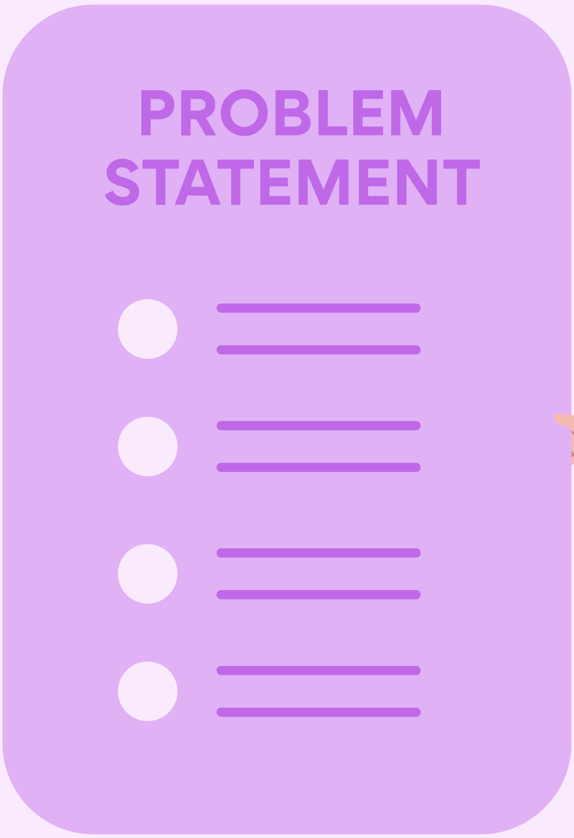
Problem Statement:
Farmers often face challenges in selecting the right crop and fertilizer due to varying soil conditions, climate, and other factors.
Traditional methods of crop and fertilizer selection are time-consuming and lack accuracy.
There is a need for a solution that:
Provides tailored crop and fertilizer recommendations based on real-time soil data.
Helps farmers optimize their agricultural practices, increasing crop yield and sustainability.

Slide 6
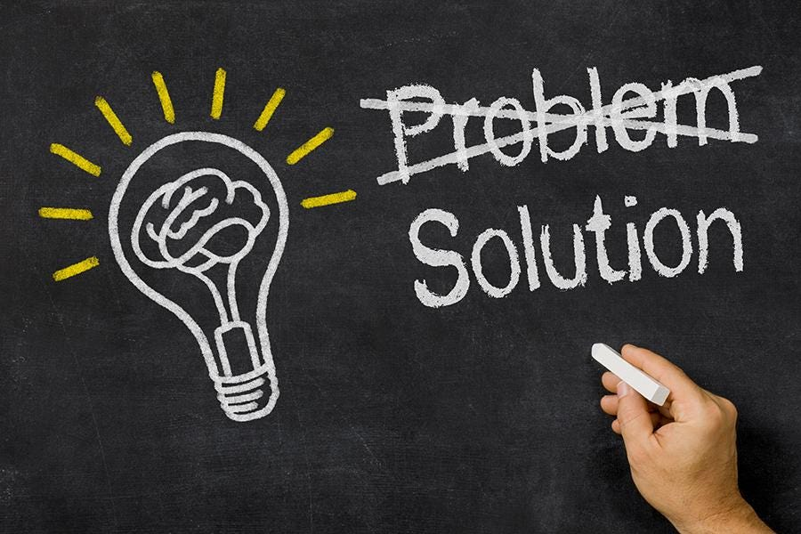
Solution:
AI-Powered Recommendation System:
Leverages machine learning to provide real-time crop and fertilizer recommendations.
Uses soil test reports (extracted via OCR from images/PDFs) as input data.
Features:
Interactive web app built with Streamlit for ease of use.
Machine learning models trained on crop and fertilizer datasets.
Personalized suggestions based on soil nutrients (NPK), irrigation type, and crop preferences.
Impact:
Helps farmers make informed decisions for higher crop yields.
Saves time and resources by suggesting optimal crop-fertilizer combinations.

Slide 7
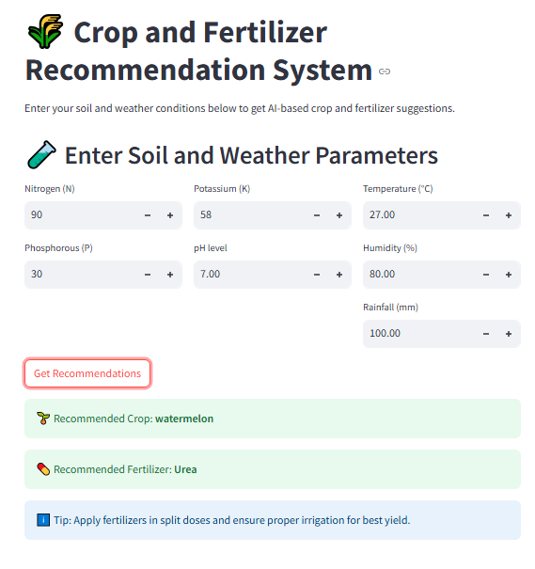
Screenshot of Output:

Slide 8

Conclusion:
The AI-powered Smart Crop and Fertilizer Recommendation System simplifies and optimizes agricultural decision-making for farmers.
By integrating machine learning with real-time soil data, the system ensures accurate and personalized crop and fertilizer recommendations.
This solution:
Enhances farm productivity.
Saves time and resources.
Contributes to sustainable agricultural practices.

Slide 9
Thank You!
Contact Information:
GitHub: https://github.com/dipanshudhage/Skill4Future

